Slide 1
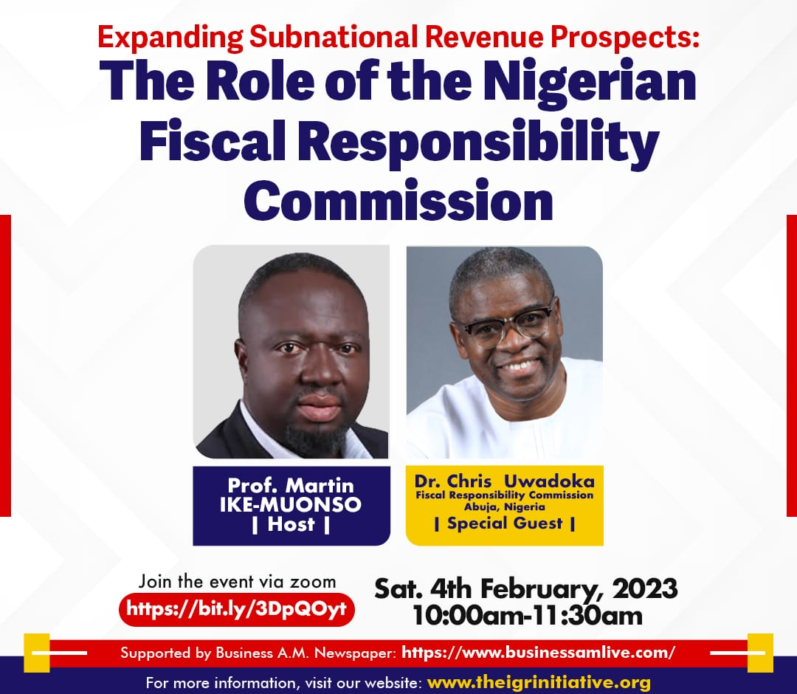
Saturday 4th February, 2023

Slide 2
AGENDA
Fiscal Responsibility Commission (FRC): WHAT it is and WHY it would have been necessary to create it if it didn’t exist
Role of FRC in expanding Public Revenue Prospects
FRC and Subnational IGRs
Closing

Slide 3

A word on the Presentation Title, “Expanding Subnational Revenue Prospects: The Role of the Fiscal Responsibility Commission”
Our focus will be on Subnational IGR (Internally Generated Revenue) Prospects
Eg: Pay As You Earn (PAYE), road taxes, direct assessment, taxes, etc

Slide 4

1. Fiscal Responsibility Commission (FRC): WHAT it is and WHY it would have been necessary to create it if it didn’t exist
Notes:
The Commission is a product of the FRA 2007:
An act to provide for prudent management of the nation's resources, ensure long-term macro-economic stability of the national economy, secure greater accountability and transparency in fiscal operations within a medium term fiscal policy framework, and the establishment of the Fiscal Responsibility Commission to ensure the promotion and enforcement of the nation's economic objectives; and for related matters

Slide 5

Fiscal Responsibility: The concept
Transparency
Prudence
Accountability
Professionalism

Slide 6
First, the Fiscal Responsibility Act (FRA 2007)
AN ACT TO PROVIDE FOR PRUDENT MANAGEMENT OF THE NATION'S RESOURCES, ENSURE LONG-TERM MACRO-ECONOMIC STABILITY OF THE NATIONAL ECONOMY, SECURE GREATER ACCOUNTABILITY AND TRANSPARENCY IN FISCAL OPERATIONS WITHIN A MEDIUM TERM FISCAL POLICY FRAMEWORK, AND THE ESTABLISHMENT OF THE FISCAL RESPONSIBILITY COMMISSION TO ENSURE THE PROMOTION AND ENFORCEMENT OF THE NATION'S ECONOMIC OBJECTIVES; AND FOR RELATED MATTERS

Slide 7
WHAT FRC DOES
Section 3.-(1) of the FRA: The Commission shall:
(a) monitor and enforce the provisions of this Act and by so doing, promote the economic objectives contained in section 16 of the Constitution;
(b) disseminate such standard practices including international good practice that will result in greater efficiency in the allocation and management of public expenditure, revenue collection, debt control and transparency in fiscal matters;
(c) undertake fiscal and financial studies, analysis and diagnosis and disseminate the result to the general public ;
(d) make rules for carrying out its, functions under this Act; and
(e) perform any other function consistent with the promotion of the objectives of this Act.

Slide 8
Why the FRA 2007 was enacted: Applying The MISCHIEF RULE
Prior to 2007
The system trusted the professionalism & sincerity of operators
Reforms, debt overhang + forgiveness
2007
FRA
2003 - 2007
No distinct law holistically covered fiscal matters relating to public expenditure planning & management in a systematic manner
Budgets, Financial regulations, PSR, etc
Notes:
There was no distinct law of its kind that holistically covered important fiscal matters relating to public expenditure planning & management in a systematic manner. Hence, there was widespread profligacy in the expenditure of public fund, a lack of culture of savings, unsustainable and reckless borrowing (both locally and externally) resulting to a serious debt overhang and deficits which, in turn, impacted negatively on national productivity, competitiveness and on investment flows into the economy.
There was lack of transparency and accountability in the fiscal system
No reasonable return on investments in revenue yielding corporations
*Corruption, Abandoned projects, Absence of defined fiscal rules

Slide 9
What FRA 2007 SEEKS to achieve
1. Rule-based budgetary system
3. Prudence in the management of public funds
4. Popular participation in determining economic priorities
6. Enhanced revenue generation & a savings culture
5. Fiscal sustainability
2. Enhanced transparency and accountability

Slide 10
What FRA 2007 SEEKS to achieve - contd
7. Limits to deficits
8. control of borrowing, debts and indebtedness
10. Medium and short term fiscal planning
11. Monitoring of budget performance
9. Prudence and value for money in public expenditure
12. Encouragement of fiscal rectitude amongst subnationals

Slide 11
2. Role of FRC in expanding Public Revenue Prospects
Sections 2 & 3(2) of the Act are very instructive, in that they provide:
Section 2(1) “For the purpose of performing its functions under this Act, the Commission shall have power to:
compel any person or government institution to disclose information relating to public revenues and expenditure; and cause an investigation into whether any person has violated any provisions of this Act.

Slide 12
Section 22 of the Act deserves special mention (it’s now been amended though):
Section 22(1) Notwithstanding the provisions of any written law governing the corporation, each corporation shall establish a general reserve fund and shall allocate thereto at the end of each financial year, one-fifth of its operating surplus for the year.
(2) The balance of the operating surplus shall be paid Into the Consolidated Revenue Fund of the Federal Government not later than one month following the statutory deadline for publishing each corporation’s accounts.

Slide 13
NB. Sec.22 of the Act has been amended by Sec.62 of the Finance Act, 2020 by substituting for Sec.22 of the Act, a new Sec.22:
Section 22(1) “Notwithstanding the provisions of any written law governing the corporation, each corporation shall establish a general reserve fund and shall allocate thereto at the end of each financial year, one-fifth of its operating surplus for the year, provided that the cost to revenue ratio of each corporation shall not exceed fifty percent or such other ratio as the Minister, upon the approval of the National Assembly, may approve for that particular corporation by way of order published in the official Gazette.

Slide 14
FRC and Subnational IGRs
Sensitization
Technical Support
Weaponizing Section 51 of the FRA 2007
Recent development: SFTAS
Notes:
The federal government (through the Commission) is also enjoined by Section 54 of the Act to provide technical and financial assistance to States and Local Governments that adopt similar fiscal responsibility legislation like the FRA 2007 for the modernization of their respective tax, financial and asset administration

Slide 15
Section 51:
“A person shall have legal capacity to enforce the provision of this Act by obtaining prerogative orders or other remedies at the Federal High Court, without having to show any special or particular interest”.
Notes:
Clearly represents a significant recognition of the ordinary citizen as a major stakeholder in the implementation of the FRA 2007.
There is yet to be an effective utilization of this important Section of the Act by the general populace in ensuring the enforcement thereof in-spite of the Commission’s sensitization efforts.

Slide 16
Thank You
Chris UWADOKA
+234 803 812 7484;
chrisuwadoka@hotmail.com
LinkedIn:
Twitter: Answerbank

