Slide 1
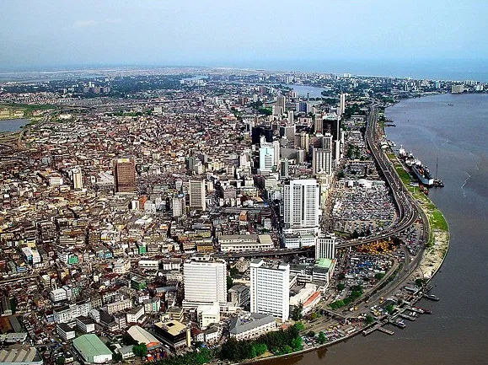
SUBNATIONAL REVENUE GROWTH: THE PLACE OF THE ORGANIZED PRIVATE SECTOR.
By
Sunnie Omeiza-Michael, Ph.D.
Director, Research and Advocacy, LCCI
SATURDAY 10TH SEPTEMBER 2022

Slide 2
Background
Government revenue since covid-19 pandemic have been stagnant. As a result, FAAC allocation to State Governments increased marginally from N2.29 trillion in 2020 to N2.50 trillion in 2021 and remained stagnant at N654.88 billion in Q1 2022.
Also, State Governments IGR have remained flat since 2019 while government expenditure have significantly increased over the same years.
Available data from CBN showed that State Governments total expenditure increased from N4.76 trillion in 2019 to N5.68 trillion in 2021, representing almost N1 trillion increased during the period.
The overall fiscal balance of State Governments’ have resulted in deficits financed largely by domestic and external borrowings.
The situation is further worsened by the Federal Government severe revenue challenges, high cost of debt services and subsidies.
2021*/H1 2021

Slide 3
Analysis of IGR by State (N’Bns)
The chart below indicates that Lagos State has the highest IGR figure of N267.23 billion which represents 31.5% of the total IGR, followed by FCT (N69.07 billion), Rivers State (N57.32 billion) and Ogun State (N54.82 billion).
The States with the least IGR are Yobe which generated N4.03 billion, Taraba (N4.77 billion) and Gombe (N5.44 billion)

Slide 4
Analysis of FAAC Allocation by State (N’Bns)
In terms of the allocation of FAAC by State, In 2021, Delta received the largest share of N192.13 billion, followed by Rivers and Akwa-Ibom States with allocations of N164.59 billion and N141.61 billion respectively. Lagos State received N137.37 billion as the fourth largest while Osun and Cross River States received the least allocation of N36.6 billion and N39.22 billion respectively.

Slide 5
Nigeria’s Debt Situation
Nigeria’s total debt stood at $100.07 billion (N41.60 trillion) as at March 31, 2022. This include external debt of $38.97 billion (N16.62 trillion) and domestic debt of N24.99 trillion ($60.10 billion). The total debt of the States and FCT was N6.43 trillion in 2021.
The implication of the country’s debt situation is high cost of debt service which is currently 90% of the budgeted revenue. Also, this has resulted in reduced government spending in priority sectors of the economy and loss of investors’ confidence.

Slide 6
Debt Profile by State
Nigeria’s total debt stood at $100.07 billion (N41.60 trillion) as at March 31, 2022. This include external debt of $38.97 billion (N16.62 trillion) and domestic debt of N24.99 trillion ($60.10 billion). The total debt of the States and FCT was N6.43 trillion in 2021.
The implication of the country’s debt situation is high cost of debt service which is currently 90% of the budgeted revenue. Also, this has resulted in reduced government spending in priority sectors of the economy and loss of investors’ confidence.
Source: DMO

Slide 7
Nigeria’s Fiscal Situation
The table shows Nigeria’s worsening fiscal performance. Budget spending is constrained by worsening revenue performance. Therefore, the major question is how will the country resolve its revenue problem?
Year | Budget Expenditure (N’Bns) | Actual Expenditure (N’Bns) | Performance (%) | Budget Revenue (N’Bns) | Actual Revenue (N’Bns) | Performance (%)
2010 | 5,159.66 | 4,046.98 | 78.44 | 3,179.87 | 2,958.73 | 93.05
2011 | 4,484.74 | 4,302.09 | 95.93 | 3,348.11 | 2,566.67 | 76.66
2012 | 4,697.21 | 4,131.23 | 87.95 | 3,561.02 | 3,131.09 | 87.93
2013 | 4,987.24 | 4,560.81 | 91.45 | 4,100.18 | 3,500.47 | 85.37
2014 | 4,695.19 | 4,123.42 | 87.82 | 3,731.01 | 3,242.30 | 86.90
2015 | 5,067.90 | 4,767.38 | 94.07 | 3,452.36 | 3,240.24 | 93.86
2016 | 6,060.48 | 5,141.94 | 84.84 | 3,855.73 | 2,947.49 | 76.44
2017 | 7,144.18 | 6,463.61 | 90.47 | 5,084.40 | 2,657.67 | 52.27
2018 | 9,120.34 | 7,511.19 | 82.36 | 7,165.87 | 3,866.49 | 53.96
2019 | 8,916.96 | 8,298.82 | 93.07 | 6,998.49 | 4,120.09 | 58.87
2020 | 10,810.81 | 10,017.26 | 92.66 | 5,365.67 | 3,418.30 | 63.71
2021 | 14,570.76 | 13,035.37 | 89.46 | 8,121.41 | 6,098.73 | 75.09
2022* | 17,319.70 | 4,717.74 | 27.24 | 9,969.17 | 1,630.60 | 16.36
2023** | 18,754.06 | NA | NA | 6,340.13 | NA | NA
2023*** | 19,760.92 | NA | NA | 8,460.44 | NA | NA
2024 | 20,780.43 | NA | NA | 10,871.73 | NA | NA
2025 | 23,052.95 | NA | NA | 12,110.62 | NA | NA
Source: Budget office of the Federation
*/as at the end of April 2022
**/scenario1-Business as usual
***/subsidy reform

Slide 8
Private Sector Revenue Contribution
The private sector contribution to government revenue through custom & excise duties (CED) and value added tax (VAT) have consistently increased to N1.30 trillion and 2.04 trillion respectively in 2021.
Company income tax (CIT), though declined in 2020 due to the effect of coronavirus pandemic, it however, recovered and increased to N1.61 trillion in 2021 from N1.48 trillion in 2020.

Slide 9
Government Initiatives to Support Private Sector Boost their Revenue
Encouraging private sector investment is essential for boosting government revenue, promoting growth and job creation across all States in the country. State Governments need to continuously carryout reforms that will ease business set up in order to attract both domestic and foreign investment.
The obstacles to investment, such as policy gaps, over-regulation and high cost of doing business should be removed.
Legal, regulatory and political stability, an efficient and ambitious trade agenda are major issues that could stimulate more investment
Efficient use of funds for infrastructure improvement and access to market through trade agreements.
Address the issues of skills gap by developing the country’s education systems. Re-training programmes and life long learning schemes have crucial role to play in providing a smooth transition to the labour market of the future. Lack of skilled workers artificially raises wages and hampers the competitiveness of companies operating the country.
Private sector activity in Nigeria continues to rely heavily on government funded projects and consumption that are ultimately supported by government revenue
Administrative reforms to bridge compliance gaps need to be enforced. The ease of collecting resource revenues renders alternative sources secondary.
Government revenue from agriculture appear to be under threat due to insecurity while revenue from manufacturing sector may be hampered by exchange rate crisis and declining purchasing power

Slide 10
Ease of Doing Business and FDI Inflows by State
LOCATION OF INVESTMENT | 2019 | 2020 | 2021 | Q12022 | Q22022
ABIA | - | 56.07 | 0.01 | - | -
ABUJA (FCT) | 6,208.81 | 1,270.17 | 833.4 | 446.81 | 453.95
ADAMAWA | 25 | 0.02 | - | - | -
AKWA IBOM | 0.06 | 1.05 | 0.74 | - | -
ANAMBRA | 0.16 | 10.02 | 4.74 | 4.15 | 24.71
BAUCHI | 0.1 | - | - | - | -
BAYELSA | - | - | - | - | -
BENUE | 25.03 | - | - | - | -
BORNO | 0.5 | - | - | - | -
CROSS RIVER | 25.85 | - | - | - | -
DELTA | 0.04 | - | 1 | - | -
LOCATION OF INVESTMENT | 2019 | 2020 | 2021 | Q12022 | Q22022
EBONYI | - | - | - | - | -
EDO | 1.87 | - | - | - | -
EKITI | - | - | 0.5 | - | 0.5
ENUGU | 0.05 | - | - | - | -
GOMBE | - | - | - | - | -
IMO | 3 | - | - | - | -
JIGAWA | - | - | - | - | -
KADUNA | 4.63 | 4.03 | - | - | -
KANO | 1.81 | 2.38 | 2.55 | - | -
KATSINA | 0.58 | - | - | 0.7 | -

Slide 11
Ease of Doing Business and FDI Inflows by State
LOCATION OF INVESTMENT | 2019 | 2020 | 2021 | Q12022 | Q22022
KEBBI | - | - | - | - | -
KOGI | - | - | - | - | 2
KWARA | 0.2 | - | 0.23 | - | -
LAGOS | 17,672.33 | 8,280.15 | 5,823.36 | 1,119.44 | 1,054.18
NASARAWA | 0.1 | - | - | - | -
NIGER | 0.07 | 16.36 | - | - | -
OGUN | 16.01 | 13.39 | 1.06 | - | -
ONDO | 0.03 | - | - | - | -
OSUN | 0.02 | - | 29.92 | - | -
OYO | 3.74 | - | 2 | 2 | -
LOCATION OF INVESTMENT | 2019 | 2020 | 2021 | Q12022 | Q22022
PLATEAU | - | - | - | 0.04 | -
RIVERS | 0.07 | - | 1 | - | -
SOKOTO | - | 2.5 | - | - | -
TARABA | - | - | - | - | -
YOBE | - | - | - | - | -
ZAMFARA | - | - | - | - | -
TOTAL | 23,990.05 | 9,656.13 | 6,700.51 | 1,573.14 | 1,535.35

Slide 12
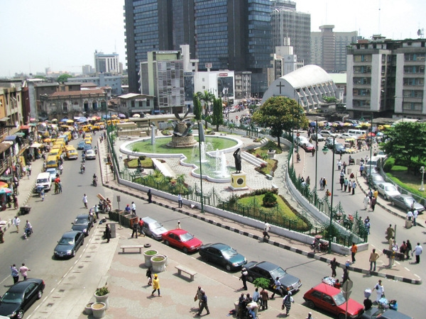
BACKGROUND AND CONTEXT
Creating the Environment
Regulatory Environment
Taxes, levies, charges (multiplication).
Duplication of agencies (Bureaucracy)
Enforcement (Best practice)
Policy Environment
Fiscal & monetary polices (certainty, stability, coordination) – Inflation, debt crises, FOREX liquidity
Digital Infrastructure
Regulation of Digital Economy (Best Practices), automation of processes
Political Stability
Sound governance, rule of law, Security, job creation, Political will for reforms, etc.
Infrastructure
Port infrastructure (to ease export) , road transport (movement of goods and persons), electricity (to power operations, factories, manufacturing), Absence of infrastructure leads to higher cost of doing business.

Slide 13

Public Policy Advocacy and engagement to ensure a conducive working environment.
International Trade Relations: Facilitation of inward and outward trade missions for businesses.
Trade promotions: Trade Fairs and Exhibitions (Lagos International Trade Fair and Specialized exhibitions).
Arbitration service for commercial disputes resolution through LACIAC.
KEY ACTIVITIES

Slide 14


