Slide 1
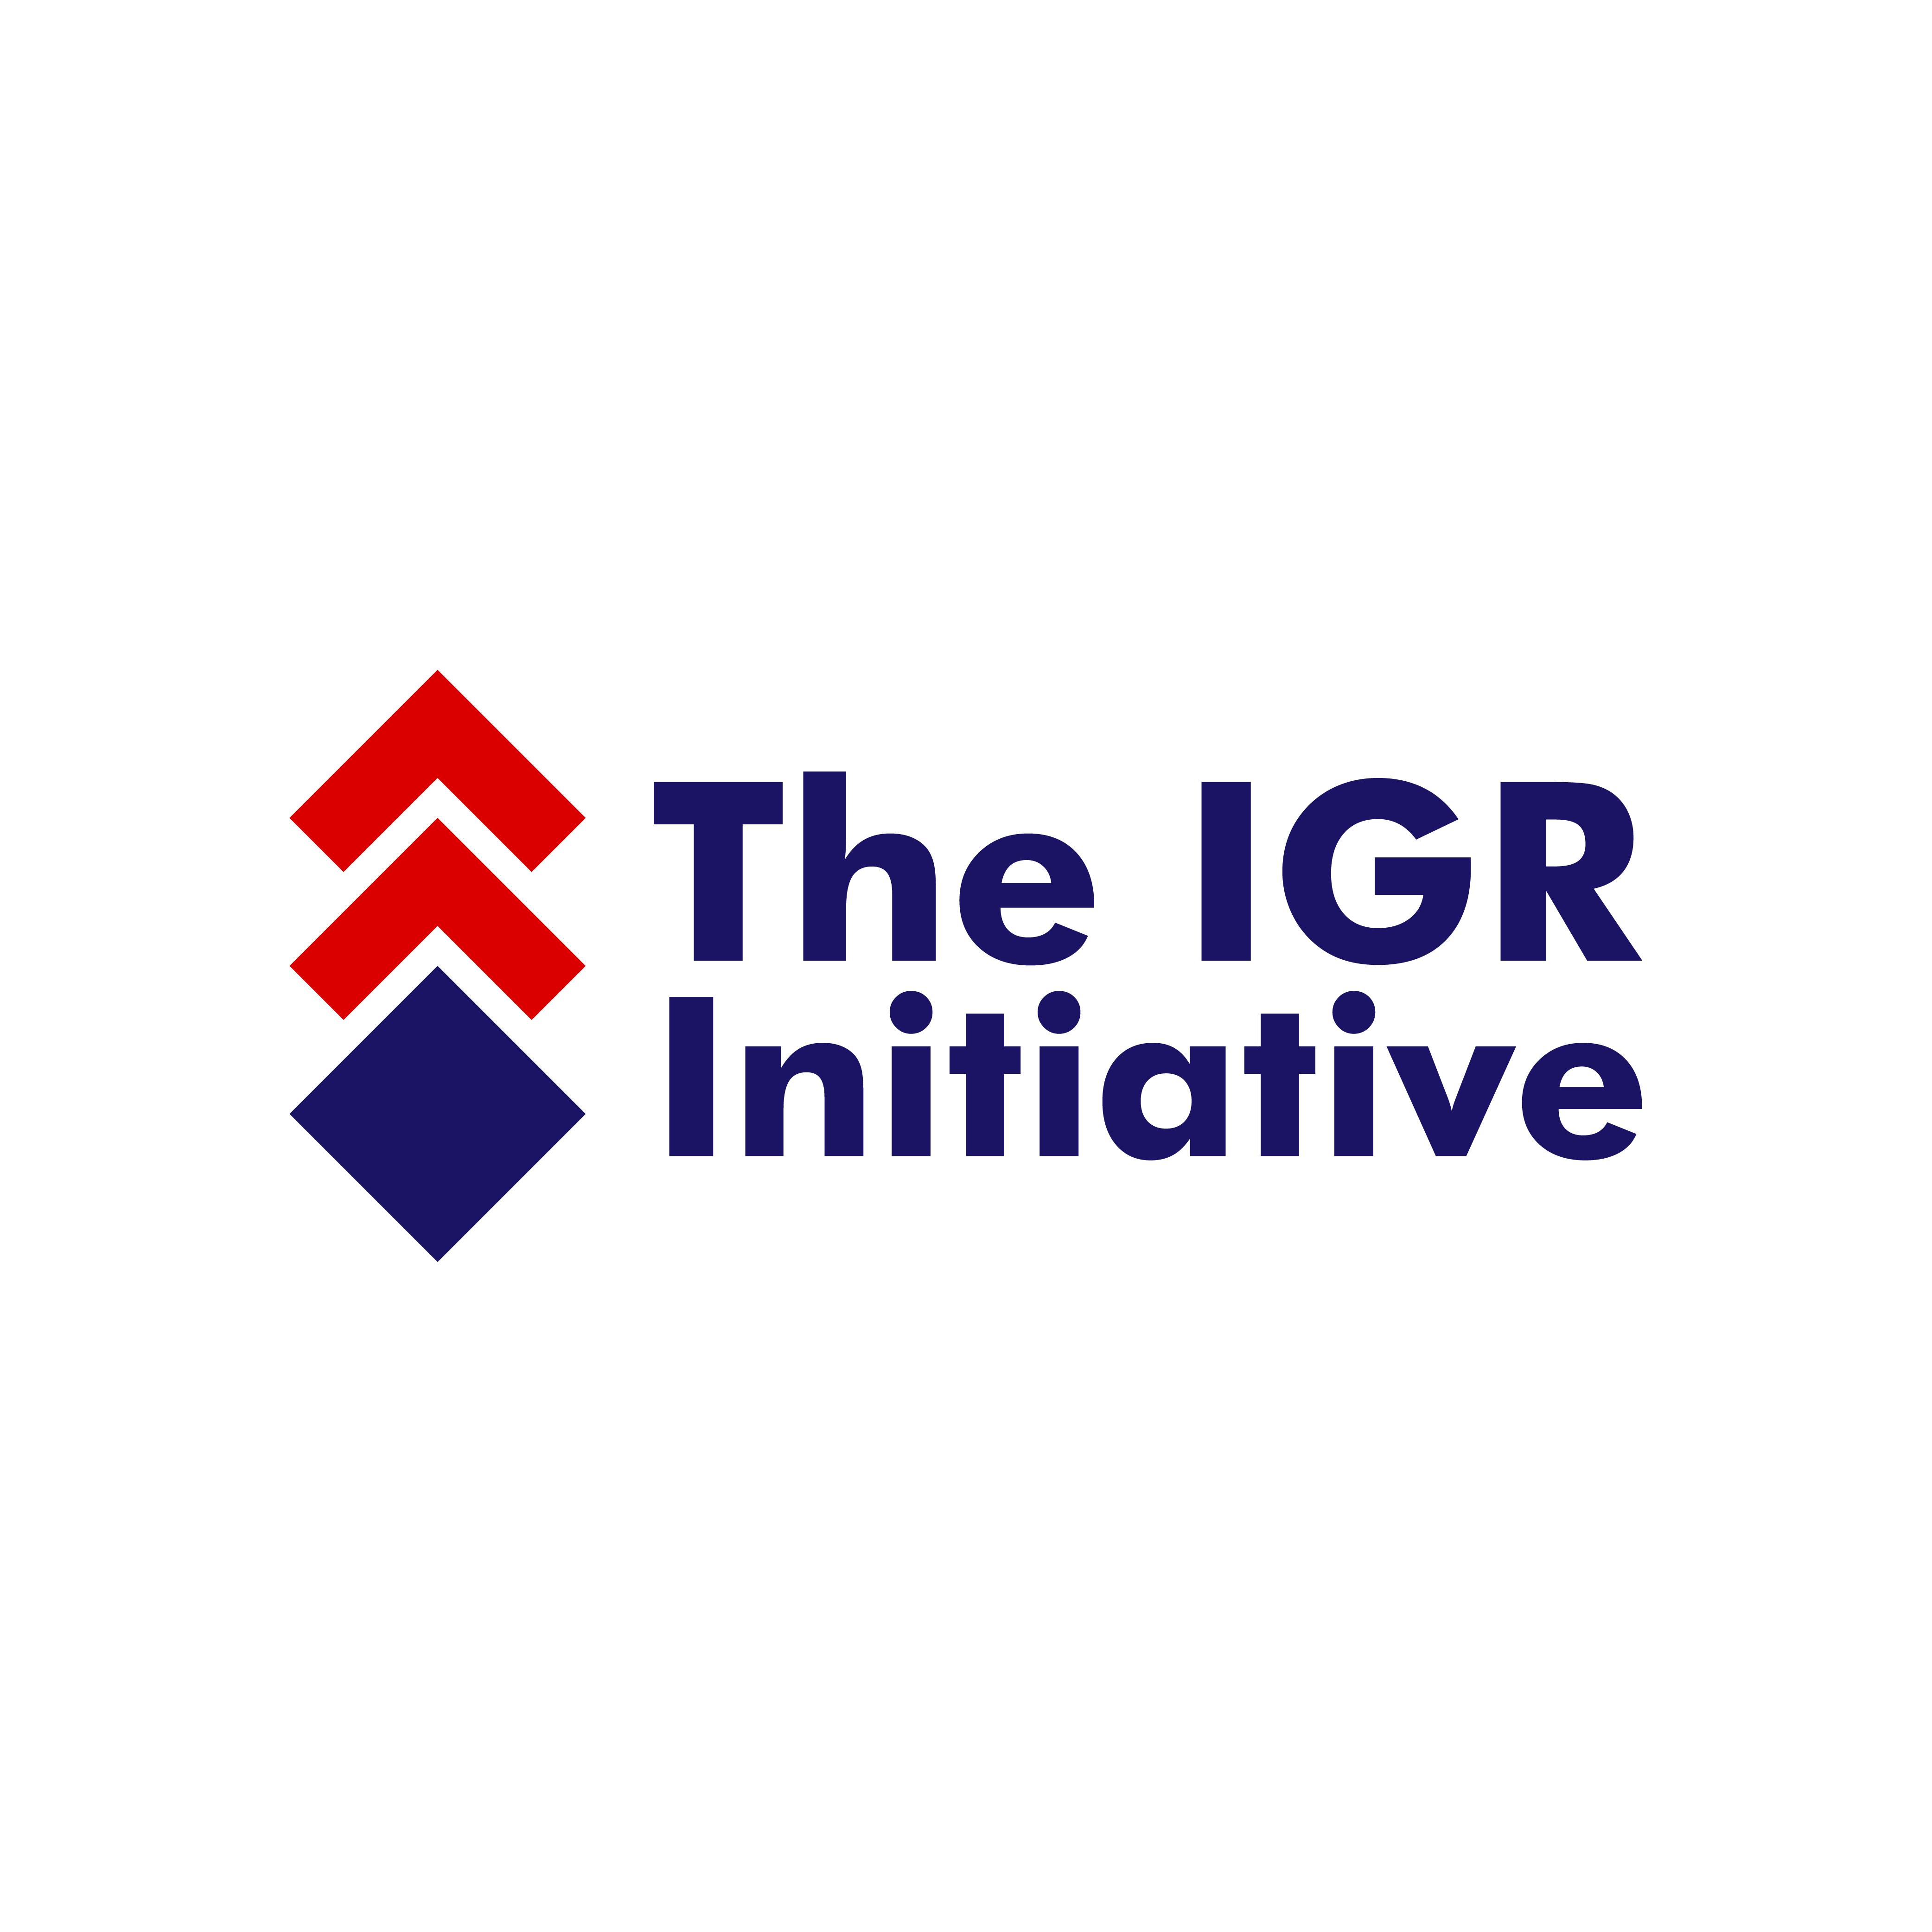

REVENUE AUDIT FOR
SUBNATIONAL IGR EXPANSION
USING AUDIT TO PROVIDE ASSURANCE FOR IGR EXPANSION
Presented by: Ismail Adeleye FCNA,FCTI, MBA, CISA
PFM AUDIT CONSULTANT

Slide 2
OUTLINE
  Introduction
  Audit objectives
  Types of Revenue/Sources of IGR
  The Audit of Internally Generated Revenue in MDAs
  Revenue Audit Life Cycle
  Tax Revenue Audit Procedure
  Improving State and Local Government IGR/ using Audit to improve IGR

Slide 3
Introduction and Audit objectives
Introduction
Over the years attention in the Public Financial Management space has been centered on the expenditure side of the divide with less attention paid to revenue side, but recent dwindling financial resources available for governments has brought attention to the Revenue side of PFM.
Revenue generation has attained a new focus as the ‘cake ‘(resources) to share’ (Expenditure) is becoming smaller whereas those to eat the cake are increasing making it necessary to put more effort into the ‘baking of the cake’ (revenue generation) for sharing.
Revenue collection is one of the high-risk areas in terms of corruption and leakage of public funds, so all significant revenue streams should be subject to audit at least once a year to try and minimise the loss of government revenue.
Internally Generated Revenue for Subnational refer to those revenue that each of the other tier of government, State and Local Government, generate other than those from FAAC and VAT shares and other centrally derived revenue sources like ecological funds etc

Slide 4
Revenue Audit objectives
Revenue Audit Objectives
Revenue audit Is crucial for the optimization of revenue collection as it help provide assurance on the process and help ensure that there are no leakages, misappropriation and mismanagement of revenue generated by those entrusted with the revenue collection and administration process; and also providing suggestions and recommendations on improvement and maximization of revenue and its administration in the various tiers of government.
The revenue collection accounting and reporting process in the past have been fraught with a lot of inadequacies, imperfection, leakages, misappropriation, embezzlement and corruption; and efforts have been made by various governments to introduce measures that will help remove the obstacles and ensuring that all revenue due are collected, accounted for and duly report ed to appropriate authorities and systems.
Introduction of the Treasury Single Account (TSA) in recent years at the Federal and some states of the Federation has changed the approach to ensure that all revenue is paid directly into one of the ministry’s/agency’s or entity’s designated bank accounts with a commercial/private bank, this has help reduce the corrupt practices around revenue collection and accounting.
Auditors therefore need to ensure and give assurance that the revenue generated (fees, charges, tax, rates, penalties, fines etc) are transferred each day from these bank accounts into the relevant revenue account for the MDA at the Central Bank of Nigeria to avoid possible ‘teaming and lading, or leakages
.

Slide 5
Objectives of Revenue Audit
The objectives of any revenue audit are to ensure that:
revenue generation is optimized in line with the relevant laws, edicts, rules and regulations covering revenue
All eligible tax, rate, fees, and other revenue payers are captured in the relevant tax administration database
Where relevant, goods and services are only provided when the relevant fees/charges have been paid
All revenue due and accruing to the government or MDA is paid directly into a designated bank account
All revenue collected is accurately coded and accounted for by the revenue collector or MDA or government
All revenue is transferred real time or daily from the revenue collector, entity or MDA’s revenue accounts in private/commercial/designated microfinance/banks to the correct designated TSA bank account or the Central Bank of Nigeria.

Slide 6
Types of Revenue/Audit of IGR
Types of Internally Generated Revenue (IGR) at the subnational
The following are some of the internally generated revenue sources available to state and local governments in Nigeria:
Rates,
Fees,
Fines,
Rents
License fees and levies
Tenements
Surplus from statutory companies and agencies
Capital Gains Tax Act
Penalties
Education Tax Act
Income
Sales
Personal Income Tax Act
Value Added Tax Act (on behalf of Federation)
Taxes and Levies (Approved List of Collection) Act etc

Slide 7
  Revenue Audit Life Cycle/Tax Revenue Audit Procedure
Revenue Audit Procedure/Life Cycle
The process or transaction life cycle for tax/other rates revenue should include one/some of these steps:
Identification of tax/rates/fees payer and the tax base, using applicable government databases,
Examination of Receipt of declarations of tax or filling of rates/fees forms or evidence of payment
Assessment of declarations to confirm whether they include all relevant information e.g. income and whether taxes/rates accurately calculated/charged.
Confirmation of recording of the class of revenues in the system of the entity/agency.
Recording of cash receipts or bank payments
Ensure appropriate Banking of cash received intact and on prescribed timely basis ( ensure no teeming and lading).
Confirm Transferring of received funds to the relevant designated TSA account in the state/ Central Bank account of the Government.
Ensure appropriate reporting of the revenue received as required by regulation
Trace the transaction to the relevant final accounts of the agency/entity or government
Carrying out above process ensures that all revenue received on behalf of the agency or government have been properly accounted for and also lead to optimization of collection of IGR in the state

Slide 8
Audit of Internally Generated Revenue
Benefits of Audit of Internally Generated Revenue
Ensures Revenue optimization/maximization
Ensures that Goods/ services are provided by government entities only after relevant fees/charges paid
Revenue audit ensure that all revenue due to each tier of government and agencies/entities are collected
Ensure all revenue collected are duly into relevant bank accounts
Confirm that Appropriate receipt issued
Ensure there’s adequate security control over treasury receipts books 6 and 6A
Verify that all revenues duly transferred to designated TSA/bank accounts/CBN
Ensure proper and timely returns made of revenue collected (Reporting)
Trace revenue collected to the last reporting point/level
Ensure that all revenues for the period have been duly accounted for.
Help block leakages, misappropriation, embezzlement and corruption in the revenue generation
Ensure improvements to revenue collection process
Contribute to general revenue administration improvement in the state and local government through audit recommendations

Slide 9
Improving State and Local Government IGR
Improving State and Local Government Internally Generated Revenue (IGR)
Increase Coverage/ Tax Net
Introduce New and modern Measures to Capture all Taxable and revenue paying adults
Ensure all revenue due is collected by Improving Collecting Mechanism
Ensure Proper Accounting for revenue collected using modern electronic methods
Ensure proper control over all security documents relating to IGR
Make Reasonable/achievable Revenue Budget/Forecast without political consideration
Get Demography of Eligible Tax payers
Utilize Revenue collected Positively effectively for provision of relevant services
Avoid and pluck all forms of leakages especially ‘teeming and lading’ and corruption around revenue collectors
Use Electronic Platform for budgeting, Collecting, Accounting and Reporting of IGR

Slide 10
Thank
You

