Slide 1
IGR Initiatives - Uganda
Antony Mwandha
Tax Administration Advisor, IMF, DFID, WATAF

Slide 2
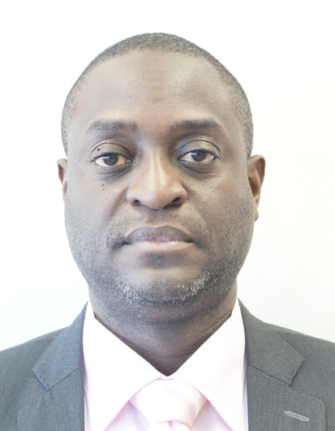
Antony Mwandha
Certified Intelligence Analyst
Special Advisor to the CG, Swaziland Revenue Authority 2016 - 2018
Tax Administrator of IMF supporting revenue compliance strategies in nine (9) countries
Business Advisor and Coach, Team building expert,
A data scientist with experience in Large Tax payersAudits for Telecoms.
Member of the Association of Chattered Fraud Examiners (ACFE
18 years’ experience in Tax Administration, rising to Manager Intelligence, Tax Investigations URA
Past President Rotary Club of Kampala South

Slide 3
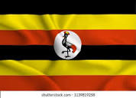
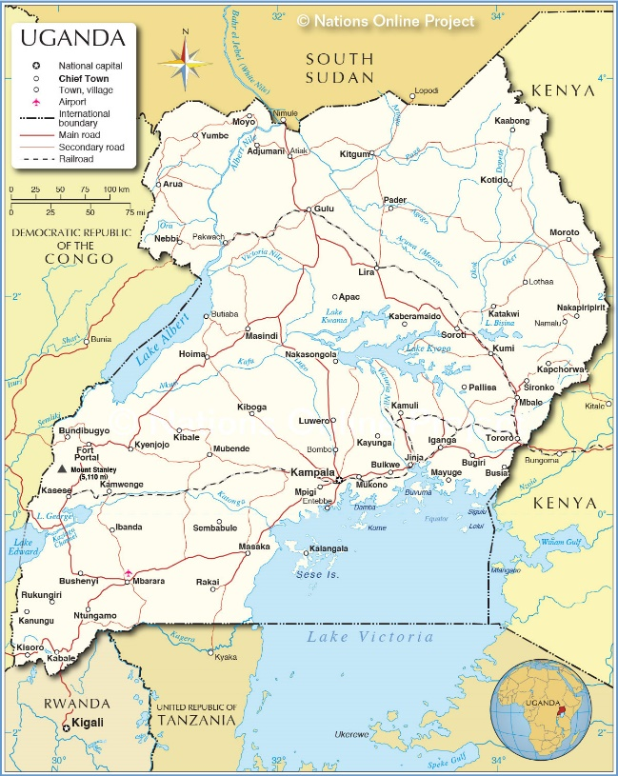
Uganda’s Economy
Uganda is a landlocked country; Democratic Republic of the Congo, Kenya, Rwanda, South Sudan, and Tanzania.
Area of 241,038 km²
The highest point is Margherita Peak Rwenzori National Park (5,110 m),
Spoken languages are English (official), Luganda, a major language of Uganda, & Swahili,

Slide 4
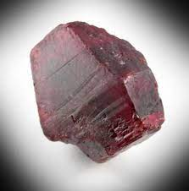


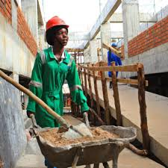
IGR Initiatives in Uganda
Precious Minerals
Copyright
Night Economy
Construction
Geo spatial Analysis

Slide 5
GEO SPATIAL ANALYIS
Source
Google
Other Sources
Local Governments
Travel
Couriers
Airlines
Security
Utility Companies

Slide 6
APPLICATION IN IGR
Intelligence
Economic Activity
Natural resources and trade,
Associates
Detection, smuggler routes, logistics areas
Corroborating associates, homes, offices, suppliers, clients
Determination of volume

Slide 7
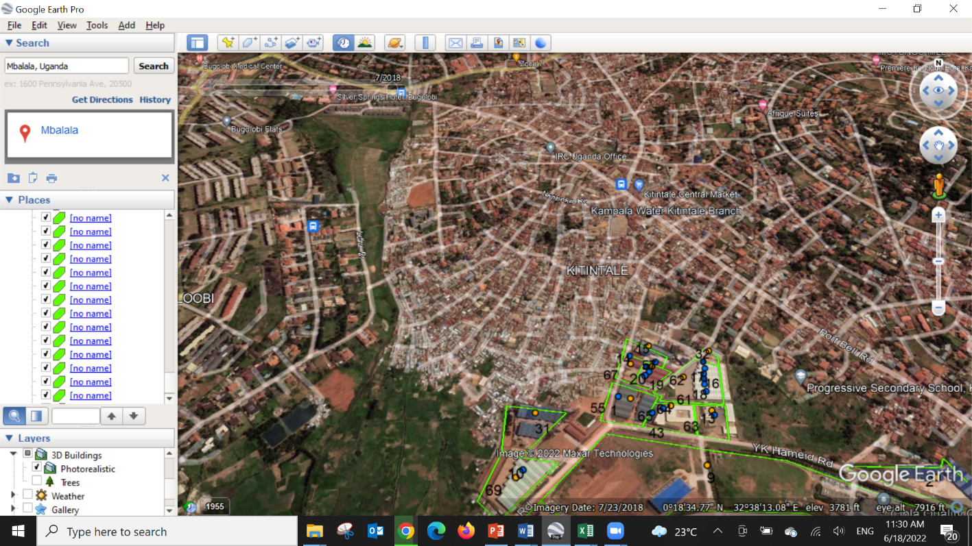
MAPS

