Slide 1



Taxation of Digital Financial Services in Nigeria: The Prospects, Politics and Challenges
By Mrs Jadesola Bello

Slide 2
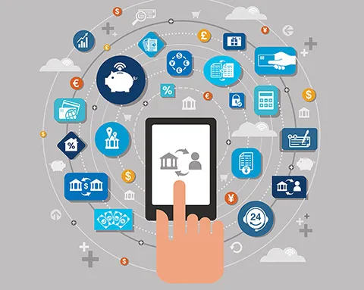
DIGITAL FINANCIAL SERVICES (DFS)
Financial services that rely on digital technologies for their deliveries and use.
Financial products and services, including payments, transfers, savings, credit, insurance, securities, financial planning and account statements that are delivered via digital/electronic technology such as e-money (initiated either online or on a mobile phone), payment cards and a regular bank account

Slide 3
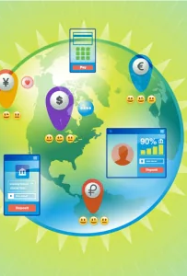
DIGITAL FINANCIAL SERVICES IN NIGERIA
Global operations: 90 countries
# 850m mobile telephony
# US$1.3m transaction per day
In Nigeria, it evolved over time (2008)to provide formal financial inclusion to the unbanked and underbanked population through innovative financial technologies/ platforms.
It’s a shift in banking services to accommodate more players in the financial institution.

Slide 4


OBJECTIVES:
To expand access to finance and promote financial inclusion (promote basic access to transaction account)
To minimize cash-based economy and increase transparency of financial transactions
To promote economic growth, increase livelihood and reduce poverty. (through intense use of transaction accounts for digital payments)
To reduce the volume of the informal economy and ultimately widen tax net (65% in 2021)

Slide 5
Nigeria Digital Financial Services Profile
Indices | 2022 |  | Financial Inclusion
Population | 216.4m (estimate)
Government bank | Central Bank of Nigeria | CBN objective: To attain 95% financial inclusion by 2024 Gaps - 38.1m unbanked adult in Nigeria (36%) 2020 | To increase use of financial services from 36.3% of the adult population in 2010 to 70% by 2020 and 95% in 2024. Actual 64.1% -2020
Financial Institutions | 26 banks. 262 active MFBs/ 976 licensed, DFIs, FinCos, Primary Mortgage Banks, Discount Houses etc. | Licensed and regulated by CBN and Associations
Fintechs (2018-2020) Bureau de Change | 144 (2021) 5689 - 2022 | Paystack, Flutterwave, E’transact, Remitta, Interswitch, Paga. O’Ride. etc | Raised US$1.09b (2021) Agency banking (O’pay,, Kudi Telco driven mobile money (Airtel. MTN, Glo, 9Mobile
Active telephone line users |  | 2018 – 61.8m, 2019 – 76.4m, 2020 –89.9m, 2021 – 101.7m
Mobile internet penetration |  | 2018 - 31.57 %, 2019 - 38.01%, 2020 - 43.62%, 2021 - 48.12% (NCC).

Slide 6
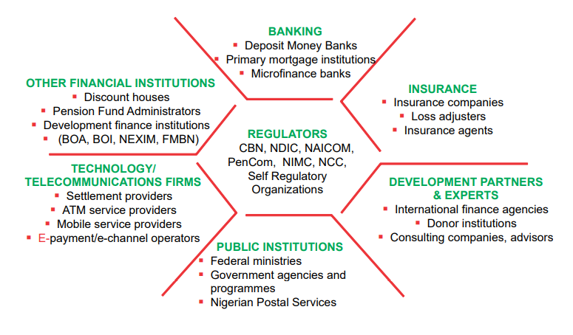
FINANCIAL SERVICES STAKEHOLDERS IN NIGERIA

Slide 7
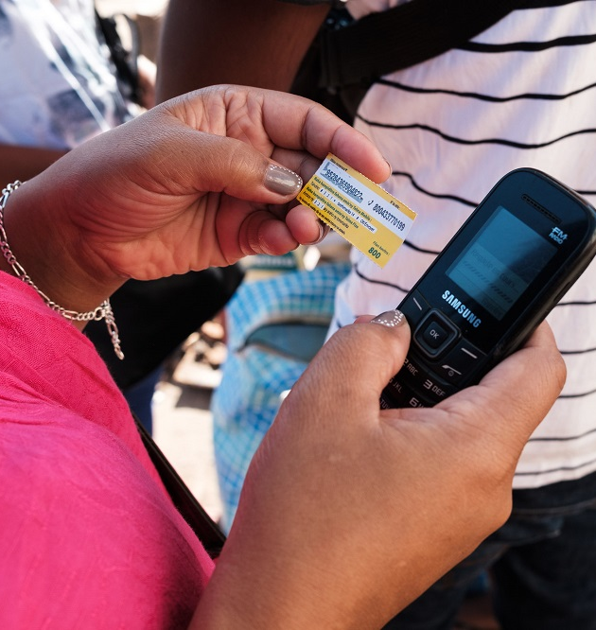
Benefits of Digital Financial Services:
Lowered cost,
Increase speed,
Maximizes economies of scale,
Security and transparency of transactions,
Tailored financial services to serve the poor,
Scaled down physical contacts

Slide 8

Channels for delivery of DFS
Agency banking: retail stores and petrol stations or via technology such as 'Point of Sale' (POS) devices and mobile phones.
Mobile banking/mobile payments: Access to financial services through mobile phones that are either directly linked to a bank account or the use of mobile wallets as intermediary virtual money accounts eg electricity bills, Pension.
Linkage model through business cooperation between traditional banking, governments, MFB providing wholesale funding for on-lending transactions e.g. NPower,

Slide 9
The Prospects
Massive opportunities abound for DFS in all sectors of the economy. Any sector that has large cache of operators transacting exchange of goods and services.
Progress on Financial exclusion
(CBN): 2008 – 53% Adults excluded (eFINA),
2010 – 46.3% (39.2m) (54.4% women)
2012 -- 39.7% (NE 59.5%, NW 63.8%, NC 32.4%, SE 25.6%, SW 24.8%, SS 30.1%)
2020 target 70% inclusion, / 64% financial inclusion achieved (67.5m), 36% excluded, (Gap - 38m adults).
2024 target - 95% financial inclusion (227.71m estimated 2024 population

Slide 10
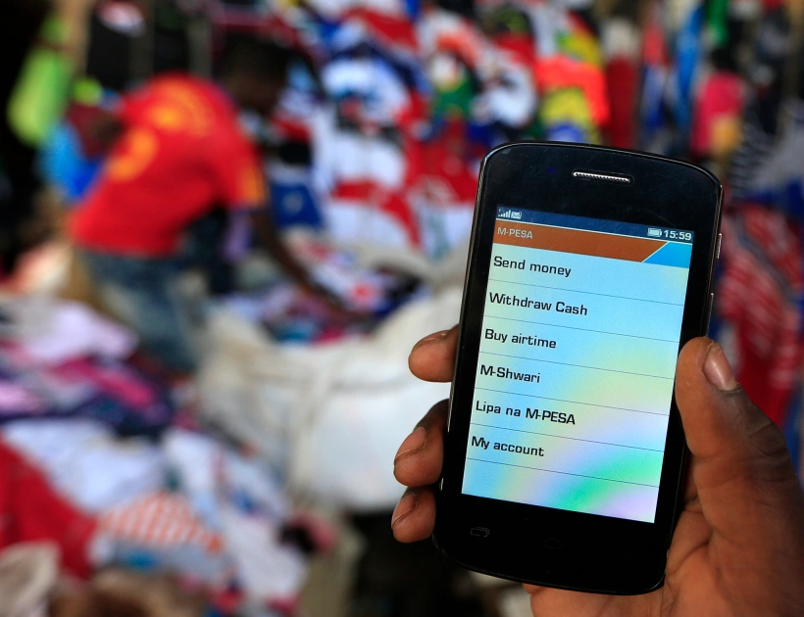
Prospects for DFS in Nigeria
Tailored products are now available for sector specific needs e.g. banking operations, logistics, agriculture, health, education, travel and lifestyle, insurance etc,
Results:
Increase no of DFS users especially the underserved adult population in remote areas where banks are not covered
65% informal economy in 2021
Connect G2B, G2P, P2G, P2P, B2P transactions
Growing population of Nigeria means internet penetration and DFS acceleration. (239m est. FY2026)

Slide 11

Implications of the 2022 Finance Act
Expands the horizon of DFS taxes to include foreign companies
“that transmits, emits or receives signals, sounds, messages, images or data of any kind by cable, radio, electromagnetic systems or any other electronic or wireless apparatus including eCommerce, app store, high frequency trading, electronic data storage, online adverts, participative network platform, online payments and so on, to the extent that the company has significant economic presence in Nigeria and profit can be attributable to such activity”
All digital transactions across Nigerian ecosystem are now taxable. VAT, WHT, CIT, PIT, Stamp duty etc.

Slide 12

Politics of DFS
Government interference and insensitivity to the Nigerian technical ecosystem on digital financial services. Eg Lagos okada ban –O’ride, restriction on cryptocurrency trading, ban of social media activities, restriction of social media platforms
Lack of government support/ funding for digital infrastructure- increased cost of doing business and ease of doing business indices are poor.
Insufficient coordination of activities of agents and mobile money operations.

Slide 13

DFA ASSOCIATIONS
Association of Licensed mobile payment Operators
Association of Non Bank Micro finance institutions
Bankers Committee
Fund Managers
Nat ass of micro finance banks
Nigeria Insurers association
Pension Fund Operators association

Slide 14

Risks and Challenges
Loss of Privacy and data governances pose risk of unauthorized disclosure and use personal data. Consumer data protection framework is required
Cyber security and operational risks (fraud and scams)
Reliance on data infrastructures which are vulnerable to cyber-attacks, system failures, and an over-reliance on third party service providers, may compromise business continuity and financial stability which is also closely related to data governance concerns.

Slide 15

TAXATION OF DFS IN NIGERIA
DFS operations are originated by structured organisations (licensed and regulated).
Banking institutions.
E’commerce platforms
Social media
Non banking financial institutions – insurance, asset, pension and wealth managers
Telcos
Fintechs
Agency banking operations – POS, Bureau de Change

Slide 16

Taxation of DFS operations
DFS operations are highly structured in principle and implementation. Its tax reporting structure depends on the incorporation and the accountability status of the service provider
Registered companies or
Agent of a registered company as individual operator or company.
Companies Assessed on profits by FIRS
WHT deduction on Companies and Individuals transactions
VAT – FIRS
Others (Education Tax, Technology tax etc
Individual operators - Direct Assessment of profits by IRS
WHT (Companies and Individuals transactions)
VAT – FIRS

Slide 17
Mobilising IGR from DFS operations
IGR expansion is rife on implementation of the 2022 Finance Act and digital transformation of financial services in Nigeria.
How can IRS leverage DFS to collect revenue from service providers
Mutual collaboration with banks and DFS providers to collect monthly charge sheet of individual WHT from all licensed operators and ensure remittance of deductions to IRS.
Build strategic relationships with DFS associations for compliance and monitoring. Create regional association for monitoring.
Create a unit within a local tax station to register POS/ kiosk businesses under the informal sector.
Create a revenue code for Kiosks & POS/ Mobile money service providers -‘street charge’
Obtain weekly/monthly schedule of Operators’POS transactions which itemize payments, deductions and charges for remittance to IRS.
Preferably deploy presumptive tax through the registered association or regular clampdown on defiant operator.

Slide 18

The Challenge
Can tax administration deploy digital services for tax administration and collection?
Is there willingness on the part of political leadership to support tax infrastructure and staff capacities?

Slide 19


Questions & Answers

