Slide 1
Enhancing Internally Generated Revenue (IGR) through Trust, Accountability and Engaged Citizenship
Professor Kenneth Amaeshi
Visiting Professor of Leadership and Financial Markets in Africa
London School of Economics, United Kingdom

Slide 2
Concepts. Context. Case. Considerations
What comes to mind when we think of trust?

Slide 3
Concepts. Context. Case. Considerations
Likely Responses
Reliability; Dependability; Faithfulness; Predictability; Steadfastness; Consistency; Stability
Query: Are these responses positive or negative?

Slide 4
Concepts. Context. Case. Considerations
Types of trust (Zucker, 1986) | Descriptions | Examples
Process-based trust | Reciprocal or recurring interactions between individuals or organisations | Interpersonal relations
Characteristic-based trust | Social similarities (e.g. family background, gender or nationality) | Social networks, professional groups
Institutional-based trust | Formal mechanisms that are not dependent on personal characteristics or on exchange history | National systems of innovation, Intellectual property regimes
Zucker, L. G. (1986). Production of trust: Institutional sources of economic structure, 1840–1920. Research in Organizational Behavior, 8, 53–111.

Slide 5
Concepts. Context. Case. Considerations
Institutions are:
  “…concrete manifestations of societal values and norms…” (Koen, 2005:5)
  ‘the rules of the game’ (North, 1990, 1991)
  coordinating and or governance mechanisms with the capacity to constrain and or enable actions at multiple levels (Grandori, 1997; Crouch, 2005)
Notes:
References:
Crouch, C, (2005). Capitalist Diversity and Change: Recombinant Governance and Institutional Entrepreneurs, Oxford University Press
Grandori, A. (1997). Governance Structures, Coordination Mechanisms and Cognitive Models. Journal of Management and Governance, 1(1):29-47
5

Slide 6
Concepts. Context. Case. Considerations
‘…differences in societal institutions encourage particular kinds of economic organization and discourage other ones through structuring the ways that collective actors are constituted, cooperate, and compete for resources and legitimacy, including standards used to evaluate their performance and behavior’ (Whitley).

Slide 7
Concepts. Context. Case. Considerations
The State
  Dominance of the state and its willingness to share risk with business
  State antagonism to collective intermediaries
  Extent of formal regulation of markets
Financial System
  Capital market – or credit-based
Skill Development and Control Systems
  Strength of public training system
Trust and Authority Relations
  Reliability of formal institutions governing trust relations

Slide 8
Concepts. Context. Case. Considerations
What comes to mind when we think of citizenship?

Slide 9
Concepts. Context. Case. Considerations
Liberal Citizenship comprises three different aspects of entitlement: civil, social, and political rights (Marshall, 1965):
  Civil rights: freedom from abuses and interference by third parties – most notably governments – (e.g. right to free market)
  Social rights: freedom to participate in society (e.g. right to education)
  Political rights: active participation in society through politics (e.g. voting and holding political offices)

Slide 10
Concepts. Context. Case. Considerations
What comes to mind when we think of
“formal institutions in Nigeria”?
Enabling (+)
Disabling (-)
Accountability

Slide 11
Concepts. Context. Case. Considerations
Tax Case Study – Research Problem
The Slippery Slope Framework (Kirchler et al. 2008) claims that tax compliance is a function of the perceived power of and trust in tax authorities.
Tax compliance is highest where perceived power and trust are high and lowest where perceived power and trust are low.
Most weak or non-enabling environments are characterised by low trust and low power (Amaeshi et al., 2015; Sikka, 2010). Does it then mean that tax compliance is not possible in such contexts?
However, we see evidence of tax compliance in non-enabling environments despite the predictions of the Slippery Slope Framework.

Slide 12
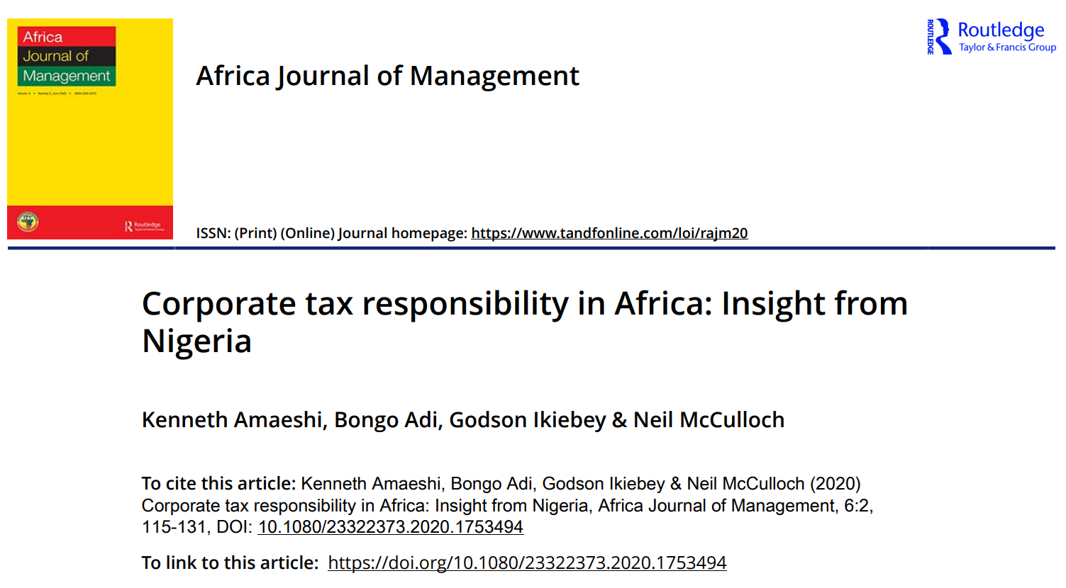
Concepts. Context. Case
Concepts. Context. Case. Considerations

Slide 13
Research Questions
Concepts. Context. Case. Considerations
How can one explain tax compliance in non-enabling institutional contexts?
How can tax compliance be enhanced in non-enabling institutional contexts?

Slide 14
Methodology
Concepts. Context. Case. Considerations
We analysed data from the following sources:
Three focus group discussion (FGD)sessions (FGDs) with diverse participation of business owners, tax practitioners and tax authorities- 28 participants in all.
Followed by five key informant interviews with subject matter experts.
A Tax Research Group with 38 participants on WhatsApp.

Slide 15
Concepts. Context. Case. Considerations
Findings (examples)
Issues | Compliance framing | Non-compliance framing | Refereence Domain
Economic, social and governance issues | “Tax payment is a responsible business practice because of its developmental purpose, which include: social amenities, public facilities, security and safety, creating an enabling environment for employment opportunities” (Interview) | “Why will l encourage tax payment by citizens where individuals provide borehole, buy generators and construct roads leading to their houses”? (WhatsApp Group) | Development
Enforcement and compliance risks and duty | “I pay my taxes because I want to sleep and sleep well” (Interview) | “But why will l support tax payment in an environment where such funds will end up in politicians pocket without any consequences” (WhatsApp Group) | Legal
Social responsibility, virtuousness and education | “I pay my taxes. I pay because it is moral and a civic responsibility” (FCDs) | “he nor dey pay tax, na me go come pay?”(If he does not pay tax, am I the one to pay?- FCDs) | Moral

Slide 16
Concepts. Context. Case
Concepts. Context. Case. Considerations
Trust-Tax-Paradox
Theme #1: Tax as an economic duty and right
Tension: Compliance before accountability vs Accountability before compliance
Theme #2: Tax as a legal duty and right
Tension: Spirit of the law vs Letter of the law
Theme #3: Tax as a moral duty and right
Tension: Right thing irrespective of benefits vs Right thing with benefits.

Slide 17
Concepts. Context. Case. Considerations
Is accountability always good?

Slide 18
Globalisation vs Glocalisation
…the politics of economics

Slide 19

Concepts. Context. Case. Considerations

Slide 20
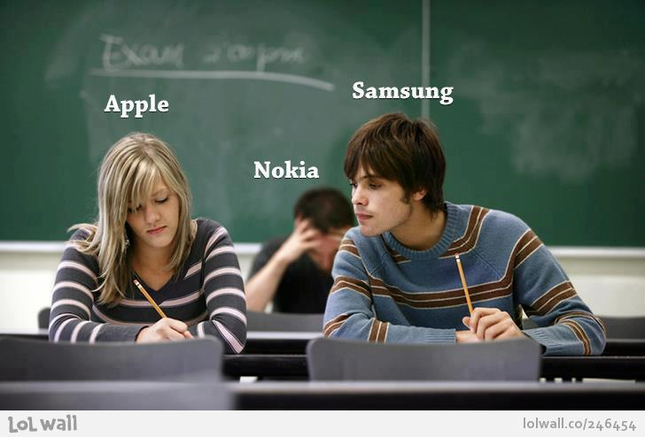
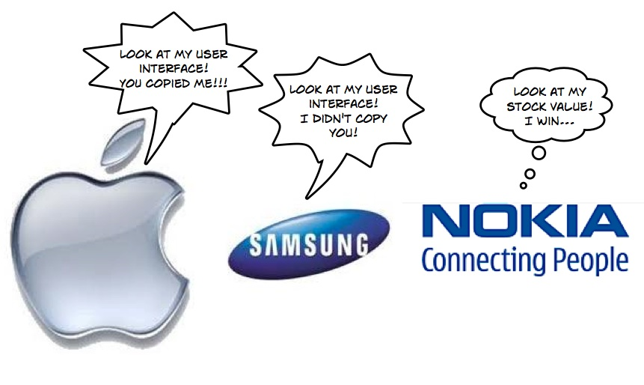
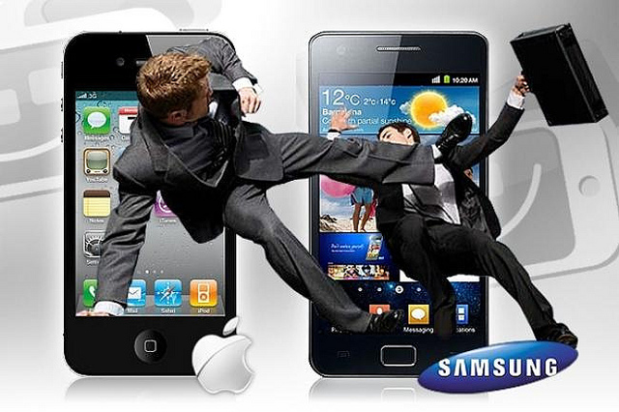
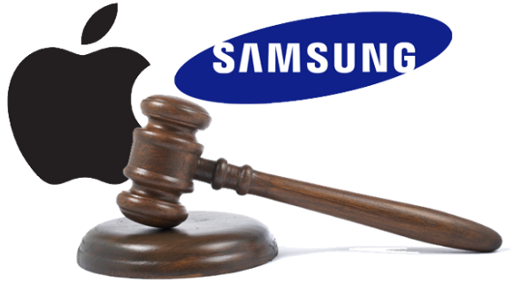

Slide 21
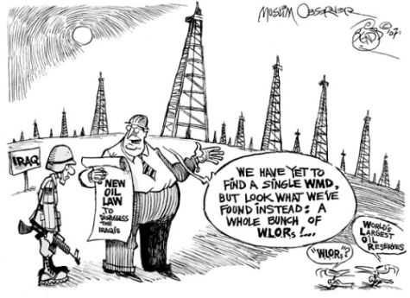
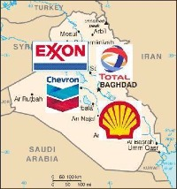
Concepts. Context. Case. Considerations

Slide 22




Concepts. Context. Case. Considerations

Slide 23
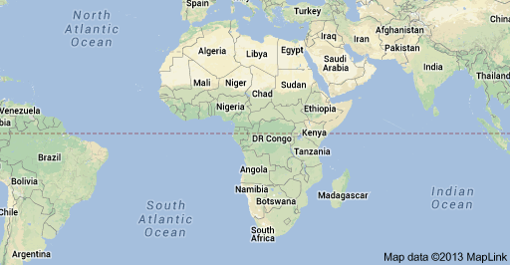
…who is thinking/fighting for Africa?
Concepts. Context. Case. Considerations

Slide 24
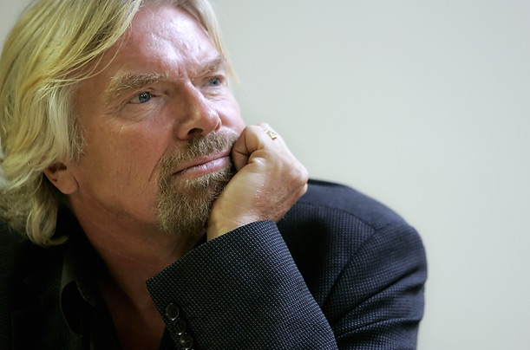
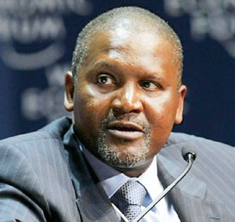
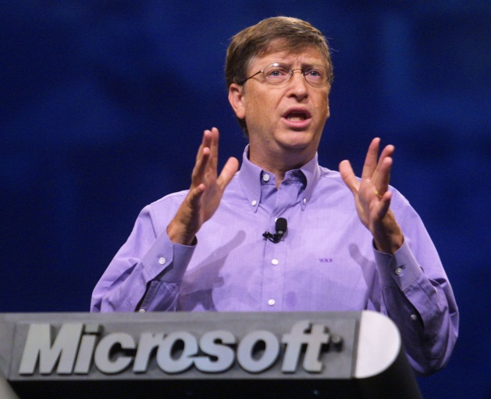
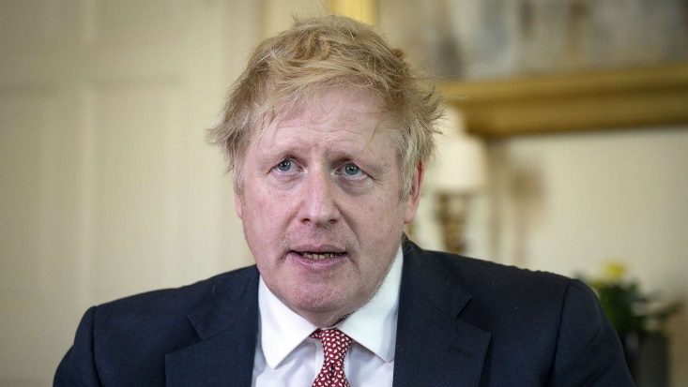
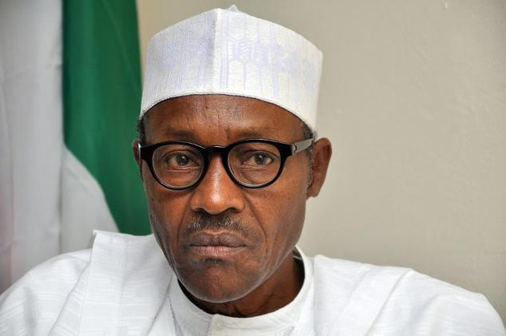
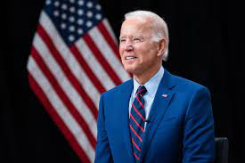
Concepts. Context. Case. Considerations

Slide 25
Concepts. Context. Case. Considerations
“The problems of the world cannot be solved by the same thinking patterns, which created the problems in the first place” Albert Einstein

Slide 26
Thank you!
Professor Kenneth Amaeshi
Visiting Professor of Leadership and Financial Markets in Africa
London School of Economics, United Kingdom

