Slide 1
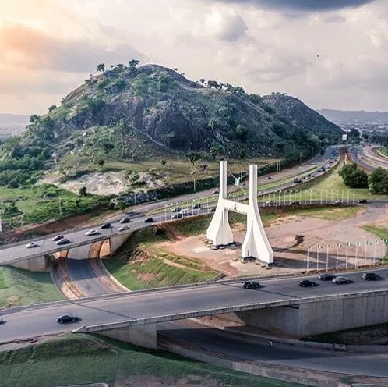
Road Tax Administration in Nigeria: Challenges and Prospects
Mr Billy Filibus
MD/CEO Fyemto Integrated Logistics & Transport Services Limited
Expert in Road Infrastructure Development, Road Tax Administration, Road Transport & Logistics

Slide 2
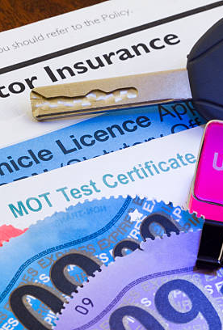
INTRODUCTION: Definitions
TAX: A tax is a compulsory financial charge or some other type of levy imposed on an individual or legal entity (taxpayer) by a governmental organization in order to fund government spendings and various public expenditures (regional, local, or national).
TAX COMPLIANCE: This refers to policy actions and individual behavior aimed at ensuring that taxpayers are paying the right amount of tax at the right time and securing the correct tax allowances and tax reliefs. A failure to pay in a timely manner (non – compliance), along with evasion of or resistance to taxation, is punishable by law.
Taxes consist of direct or indirect taxes and may be paid in money or as its labour equivalent. An economic definition, by Atkinson, states that “….direct taxes may be adjusted to the individual characteristics of the taxpayer, whereas indirect taxes are levied on transactions irrespective of the circumstances of buyer or seller.”

Slide 3
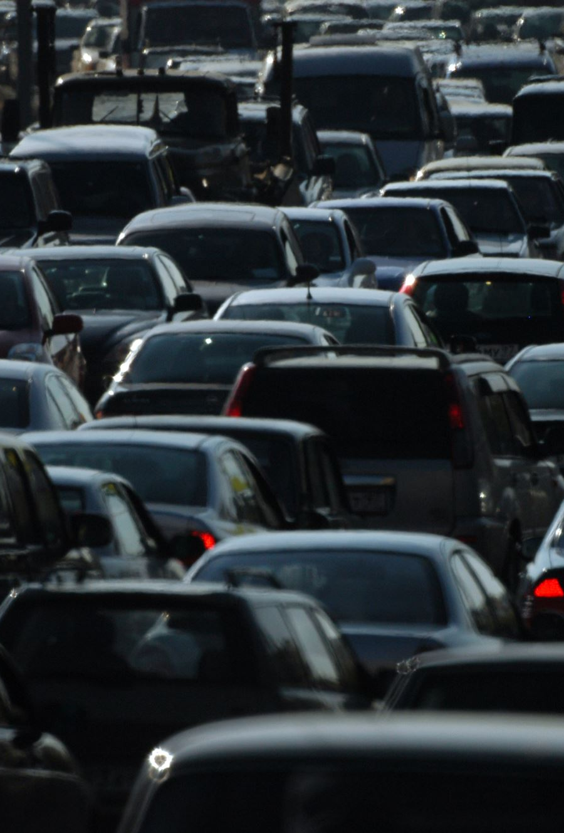
INTRODUCTION: Definitions
ROAD TAX: is known by various names around the world, is a tax which has to be paid on, or included with, a motorized vehicle to use it on a public road.
MOTOR VEHICLE ADMINISTRATION:
In the world over and in broader terms, Motor Vehicle Administration involves total planning, organizing, controlling and managing of all aspects of vehicle registration, documentation and licensing, vehicle inspection, testing and certification, drivers’ training, testing and licensing, highway and streets patrols to enforce relevant traffic rules and regulations, traffic management and control, road traffic safety programmes and all other matters related thereto.

Slide 4
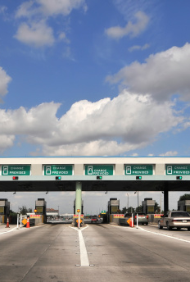
IMPLEMENTATION OF ROAD TAXES ACROSS THE GLOBE
AUSTRALIA: All states and territories requires an annual vehicle registration fee to be paid in order to use a vehicle on public roads; the cost of which varies from state to state and is dependent on the type of vehicle.
BELGIUM: Passenger cars pay registration fee based on the engine displacement and power output (degressive towards 2014 - 66% in 2012, 33% in 2013, 0% in 2014) and environmental criteria such as CO2 g/km output (increasingly towards 2014). The more CO2 g/km the car produces, the higher the fee will be.
BRAZIL: In Brazil, the states may collect an annual Vehicle Licensing Fee which has a fixed value for each vehicle category determined by each state. In addition, each state may impose a Vehicle Property Tax, with a rate up to 4%.

Slide 5
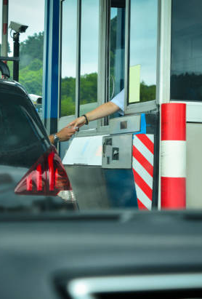
IMPLEMENTATION OF ROAD TAXES ACROSS THE GLOBE
GERMANY: In Germany, the Motor Vehicle Tax is an annual tax on all vehicles.
HONG KONG: In Hong Kong, the licence fee is according to the category (passenger cars, goods vehicles, taxis, etc) of the vehicle first.
HUNGARY: In Hungary, since 2009, this tax is based on the vehicle’s engine performance and the vehicle age. Before this so – called performance tax, this tax was based on the vehicle weight and unofficially it was called a weight tax.
INDIA: In India, road tax is imposed by the respective state governments (lifetime and also annual for commercial vehicles) also, further there could be toll for specific usage of roads (charge depends on distance, type, etc). Each state has different rules and regulations for charging the road tax.

Slide 6

IMPLEMENTATION OF ROAD TAXES ACROSS THE GLOBE
NETHERLANDS: In Netherlands, a tax is applied to the vehicle based on its weight and fuel type, and the region. Electric vehicles and classic cars over forty years old are exempted from road tax.
UNITED KINGDOM: In the United Kingdom it is a requirement to pay ’Vehicle Excise Duty’ which is paid annually to the government for a vehicle licence.
UNITED STATES: Each state requires an annual registration fee which varies from state to state. Additionally, in some states, counties and/or municipalities are allowed to also impose a vehicle tax.

Slide 7
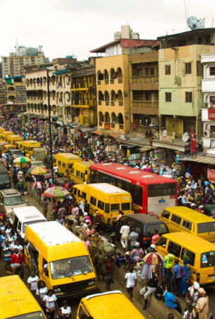
NIGERIA
ROAD TAX ADMINISTRATION DEPARTMENT / BOARD OF INTERNAL REVENUE: is responsible for the collection of Motor Vehicle registration, renewal of number plates and drivers licence fees, fines and other related trade licence payment and distribution of permanent licence to applicants.
The Road Tax Administration has the following functions:
Registration and renewal of motor vehicles, motorcycles and tricycles security licensing documents commonly referred to as motor vehicles particulars.
Ordering and administration of identification marks or number plates from the Federal Road Safety Corps (FRSC) Plant where number plates are processed for the registration of motor vehicles, motorcycles and tricycles for private and commercial purposes in the state.
Registration and administration of special permits for auto dealers, spare-parts dealers and mechanic workshops to ensure that they are properly licensed to operate for commercial purposes to enhance road traffic and motor vehicle administration in the state.

Slide 8
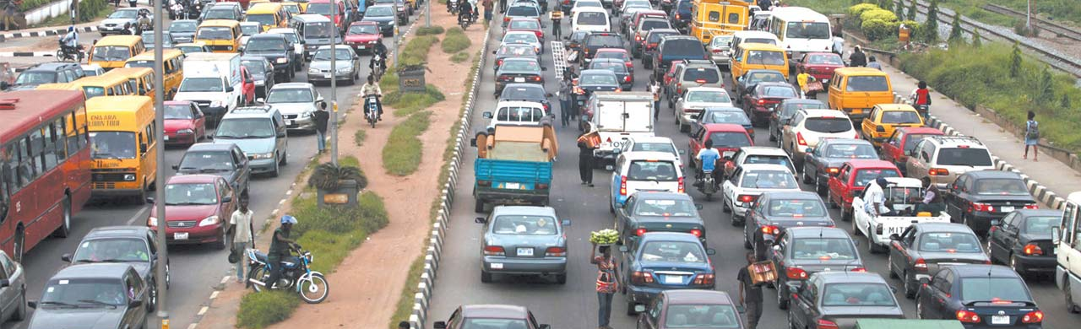
NIGERIA
To ensure effective collaboration with the FRSC and VIO for the administration and issuance of National Drivers Licence in collaboration under a tripartite arrangement in the state
To maintain a central database management system with the introduction of electronic online vehicle registration to automate all the manual process of motor vehicle registration, renewal of security licensing and other related road taxes documents in the state.
Establishing a One Stop Shop in all the Motor Licensing Authority (MLAs) offices using technology to drive tax administration for the purpose of optimizing Internally Generated revenue (IGR) in the state
Promote transparency and accountability in road tax administration.

Slide 9
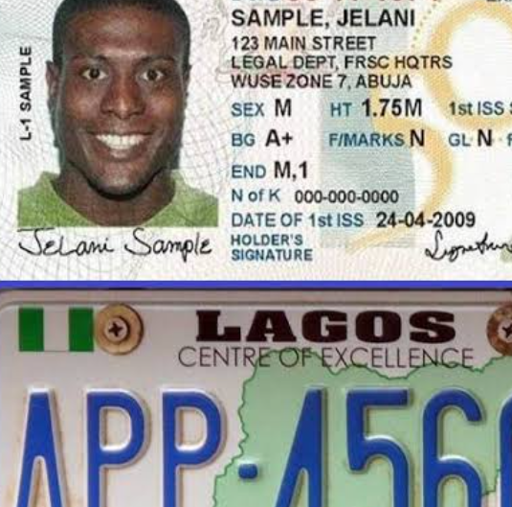
NIGERIA
To ensure effective collaboration with the FRSC and VIO for the administration and issuance of National Drivers Licence in collaboration under a tripartite arrangement in the state
To maintain a central database management system with the introduction of electronic online vehicle registration to automate all the manual process of motor vehicle registration, renewal of security licensing and other related road taxes documents in the state.
Establishing a One Stop Shop in all the Motor Licensing Authority (MLAs) offices using technology to drive tax administration for the purpose of optimizing Internally Generated revenue (IGR) in the state
Promote transparency and accountability in road tax administration.

Slide 10
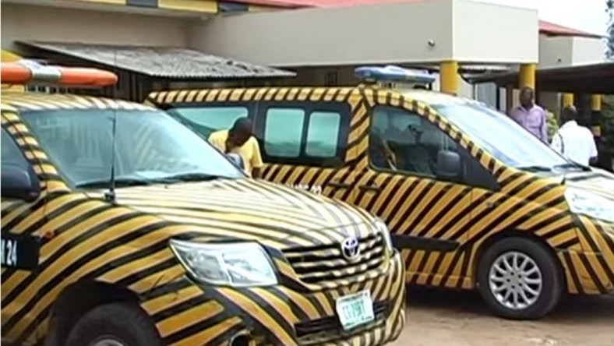
NIGERIA
FEDERAL ROAD SAFETY COMMISSION (FRSC): FRSC is responsible for designing and production of the National Driver’s Licence. FRSC has Driver’s Licence Capture (DLC) centres where successful applicants are captured to obtain their processed Driver’s Licence across the states and FCT respectively.
ROAD TRAFFIC DEPARTMENT (VIO’s): The Road Traffic Department are responsible for testing and presenting applicants for the Driver’s Licence to FRSC for capture. VIOs administers driving test which comprises both on-the-road and off-the-road testing. An applicant for Driver’s Licence MUST pass the VIO test before going to FRSC for licensing processing.

Slide 11

THE IGR ADVANTAGE
Increased accountability (Payments go to the right account since everything is run through the platform)
Potential to Reduce/Eliminate process abuse (All activities are logged and can be audited easily).
Plug revenue leakages easily instantly increasing collections (all fines are recorded electronically)
More revenue from possible interest imposed on late payment of tickets.
Enforcement is easy since payment will be tied to vehicle license renewal

Slide 12
BENEFITS
Enhanced safety of lives and property on roads
Combating Crime
Enhanced Revenue Generation
Job Creation
Reduction in Traffic congestion
Smooth flow of traffic thus reduction in man-hour loss
Improving efficiency and adding value to existing transport resources
Clean City
Centralized Information System
Easy Data Management & Retrieval
Real Time IT Solution

Slide 13
CHALLENGES
The short fall in the revenue is attributed to the following reasons:
Inadequate personnel, especially the Road Traffic Officers (VIOs)
Inadequate patrol and towing vehicles
Inadequate First Aid and ambulance services
Inadequate road traffic equipment and Uniforms for Road Traffic Officers (VIOs)
Insecurity due to mob action by political thugs
Insufficient funding due to paucity of funds
Obsolete road traffic laws and absence of well-articulated enabling law.
Lack of security at impound sites
Lack of regular and periodic training for staff of the MDAs
Low level of publicity and enforcement
Infrastructural deficiency and inadequate trained manpower.

Slide 14
REQUIRED GOVERNMENT SUPPORT & INTERVENTION
Political Will
Enabling Laws
Budgetary Provision
Infrastructure
Man-power
Regulations, Monitoring, and Coordination of Commercial Riders
Security & Safety
Training (Local & International)
Publicity & Awareness
Enforcement

Slide 15
PROSPECTS: POTENTIAL SOURCES OF REVENUE
Computerized Vehicle Inspection Test Centres
Computer Base Driving Knowledge Test Centres
Issuance of Special permits and trade licences,
Biometric Capture of Commercial Motorcycle and Tricycle Riders and issuance of riders cards for crime prevention
Training and evaluation of professional / commercial drivers and issuing of professional driving certificate
Training of fleet operators and managers
Formulation of Road Safety Policy for companies
Manual and Electronic enforcement of traffic offences and fine solutions on road taxes in the states and FCT

Slide 16
CONCLUSION
The Federal and States tax authorities should strengthen collaboration among themselves so as to enhance revenue collection and the Joint Tax Board should encourage effective collaboration and synergy amongst stakeholders as a means of providing better services for taxpayers and increased Internally Generated Revenue (IGR).

Slide 17

Thank you for listening!

Slide 18

Questions?

